Slide 1
Operations of the Computer Hardware
The following sequence of instructions adds four variables:
add a, b, c # The sum of b and c is placed in a
add a, a, d # The sum of b, c, and d is now in a
add a, a, e # The sum of b, c, d, and e is now in a

Slide 2
Operations of the Computer Hardware
The number of operands for an operation like addition is 3
Requiring every instruction to have exactly three operands, no more and no less
This keeps the hardware simple
Hardware for a variable number of operands is more complicated than hardware for a fixed number.
Design Principle 1: Simplicity favors regularity

Slide 3
Registers
The operands of arithmetic instructions are restricted; they must be from a limited number of special locations built directly in hardware called registers.
The size of a register in the MIPS architecture is 32 bits (word)
The number of registers is limited, 32 on MIPS.
Design Principle 2: Smaller is faster

Slide 4
Registers
A very large number of registers may increase the clock cycle time simply because it takes electronic signals longer when they must travel farther.
So, 31 registers are faster than 32?
Balance between the craving of programs for more registers with the designer’s desire to keep the clock cycle fast.
More than 32 register increase the number of bits it would take in the instruction format

Slide 5
Registers
f = (g + h) – (i + j);
The variables f, g, h, i, and j are assigned to the registers $s0, $s1, $s2, $s3, and $s4, respectively.
add $t0,$s1,$s2 # register $t0 contains g + h
add $t1,$s3,$s4 # register $t1 contains i + j
sub $s0,$t0,$t1 # f gets $t0 – $t1, which is (g + h)–(i + j)

Slide 6
Registers
Where do store arrays and structures?
Arithmetic operations occur only on registers in MIPS instructions
Thus, MIPS must include instructions that transfer data between memory and registers!
Such instructions are called data transfer instructions.

Slide 7
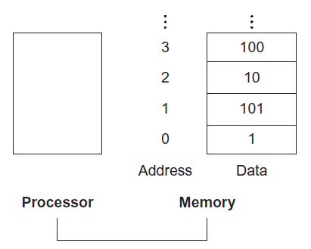
To access a word in memory, the instruction must supply the memory address
Memory is just a large, single-dimensional array, with the address acting as the index to that array, starting at 0
Notes:
Memory[2] is 10

Slide 8
From Memory to Registers
g = h + A[8];
Let’s also assume that the starting address, or base address, of the array is in $s3
$s3 is the base register
8 is the offset
lw $t0,8($s3) # Temporary reg $t0 gets A[8]
add $s1,$s2,$t0 # g = h + A[8]

Slide 9
From Memory to Registers
In MIPS, words must start at addresses that are multiples of 4
This requirement is called an alignment restriction

Slide 10
From Memory to Registers
Computers divide into those that use the address of the left most or “big end” byte as the word address
Versus those that use the rightmost or “little end” byte.
MIPS is in the big-endian camp

Slide 11
From Memory to Registers
Since 8-bit bytes are useful in many programs, virtually all architectures today address individual bytes
Byte addressing also affects the array index
To get the proper byte address in the code above, the offset to be added to the base register $s3 must be 4 8, or 32, so that the load address will select A[8] and not A[8/4]

Slide 12
From Registers to Memory
A[12] = h + A[8];
lw $t0,32($s3) # Temporary reg $t0 gets A[8]
add $t0,$s2,$t0 # Temporary reg $t0 gets h + A[8]
sw $t0,48($s3) # Stores h + A[8] back into A[12]

Slide 13
From Registers to Memory
Many programs have more variables than computers have registers.
The compiler tries to keep the most frequently used variables in registers and places the rest in memory, using loads and stores to move variables between registers and memory.
The process of putting less commonly used variables into memory is called spilling registers.
Notes:
Registers are faster, because can operate and load in one instruction, but you load from mem in one and operate later in reg
The also consume less power than memory

Slide 14
Constants and Immediate Operands
The add instruction with one constant operand is called add immediate or addi
To add 4 to register $s3, we just write:
addi $s3,$s3,4 # $s3 = $s3 + 4
The constant is part of the instruction. They are much faster and use less energy in this way.

Slide 15
Constants and Immediate Operands
What does this instruction do?
add $s1, $s2, $zero
MIPS dedicates a register $zero to be hard-wired to the value zero.
Common case fast!
Notes:
Just a move!

Slide 16
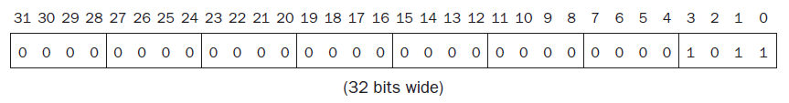
Signed and Unsigned Numbers
123 base 10 -> 1111011 base 2
The drawing below shows the numbering of bits within a MIPS word and the placement of the number 1011 base 2

Slide 17
Signed and Unsigned Numbers
Computer programs calculate both positive and negative numbers
The most obvious solution to represent them is to add a separate sign (a single bit)
The name for this representation is sign and magnitude

Slide 18
Signed and Unsigned Numbers
1st problem:
Where to put the sign bit. To the right? To the left ?
2nd problem:
Adders for sign and magnitude may need an extra step to set the sign because we can’t know in advance what the proper sign will be.
3rd problem:
A separate sign bit means that sign and magnitude has both a positive and a negative zero, which can lead to problems for inattentive programmers

Slide 19
Signed and Unsigned Numbers
The final solution was to pick the representation that made the hardware simple:
leading 0s mean positive
leading 1s mean negative
This convention for representing signed binary numbers is called two’s complement representation.

Slide 20
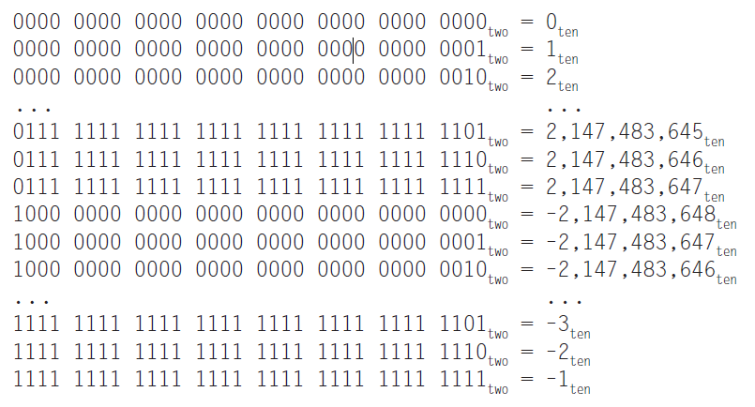
Notes:
The only problem: Two’s complement does have one negative number, 2,147,483,648ten, that has no corresponding positive number

Slide 21
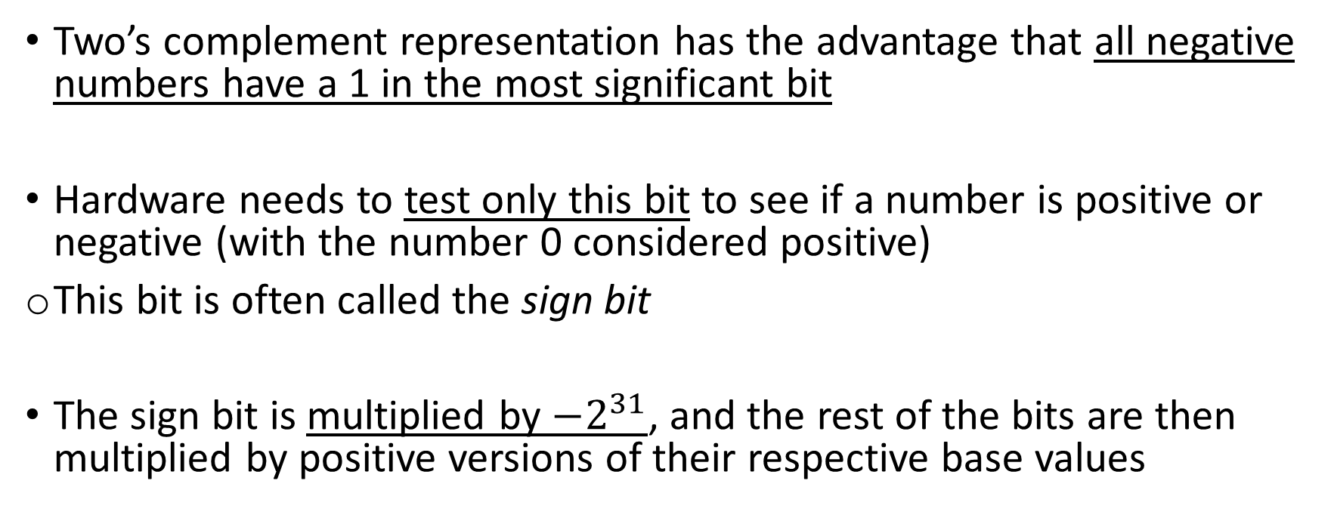
Signed and Unsigned Numbers
Two’s complement representation has the advantage that all negative numbers have a 1 in the most significant bit
Hardware needs to test only this bit to see if a number is positive or negative (with the number 0 considered positive)
This bit is often called the sign bit
The sign bit is multiplied by $−2^{31}$, and the rest of the bits are then multiplied by positive versions of their respective base values

Slide 22
Signed and Unsigned Numbers
Let’s examine two useful shortcuts when working with two’s complement numbers.
Negation shortcut
The first shortcut is a quick way to negate a two’s complement binary number. Simply invert every 0 to 1 and every 1 to 0, then add one to the result.
Sign Extension
The second is a way to raise the number of bits that represent a number. Take the sign bit and replicate it to fill the new bits of the larger quantity.

Slide 23
